Slide 1

15-11
1180301017 吴畏嶙
Notes:
有没有不同意见？
答对的同学请举手

Slide 2
习题15.11
C语言函数f的定义如下：
int f(int x, int *py, int **ppz)
{
**ppz+=1;
*py+=2;
x+=3;
return x + *py + **ppz;
}
变量a是指向b的指针，变量b是指向c的指针，c是整型变量并且当前值是4。那么执行f(c，b，a)的返回值是多少?

Slide 3
函数初始化
Address3 → | address2 | a(**ppz)
Address2 → | address1 | b(*py)
address1 → | 4 | c(x)

Slide 4
 | address2 | **ppz
形参 | address1 | *py
 | 4 | x
Address3 → | address2 | a
Address2 → | address1 | b
address1 → | 4 | c

Slide 5
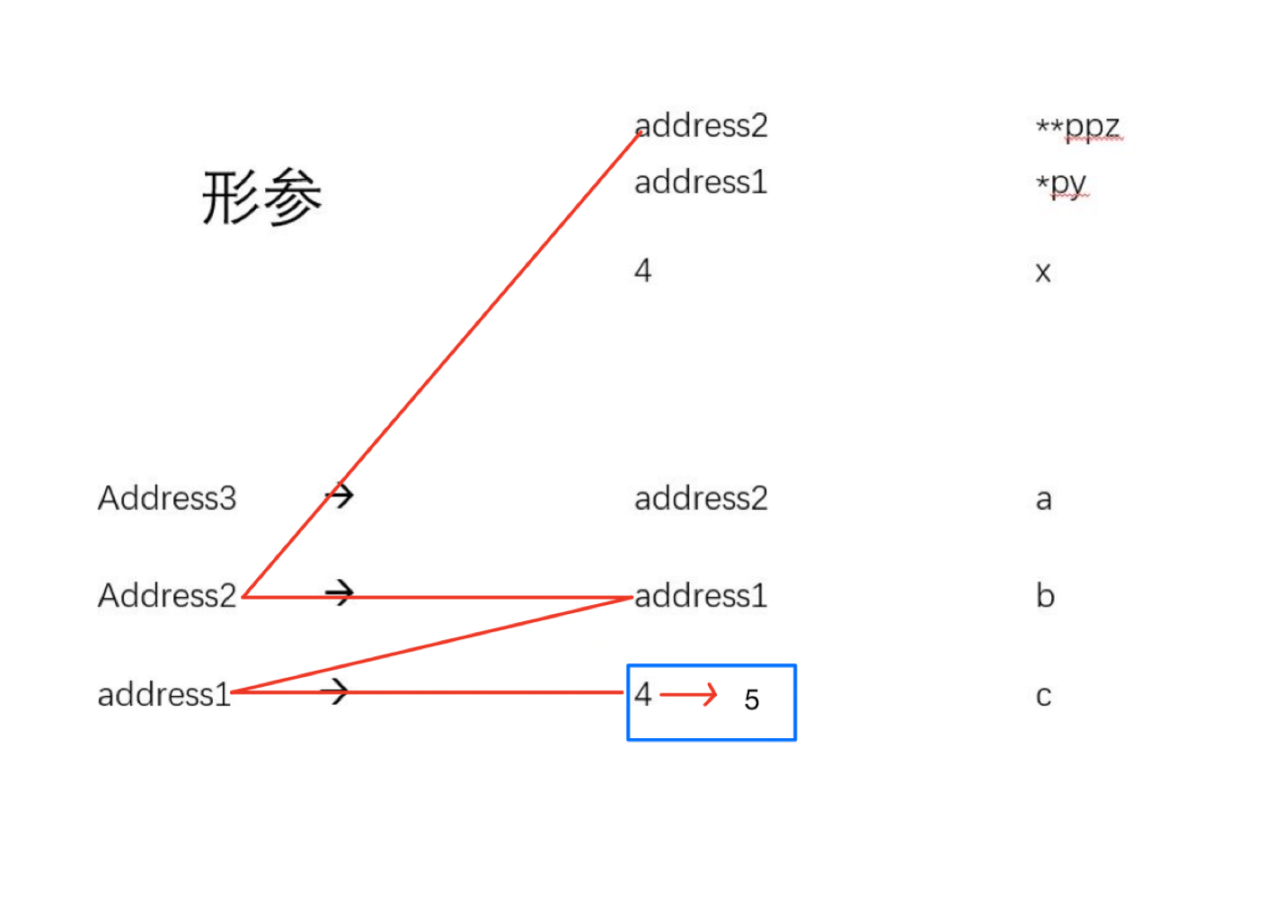
**ppz+=1;

Slide 6
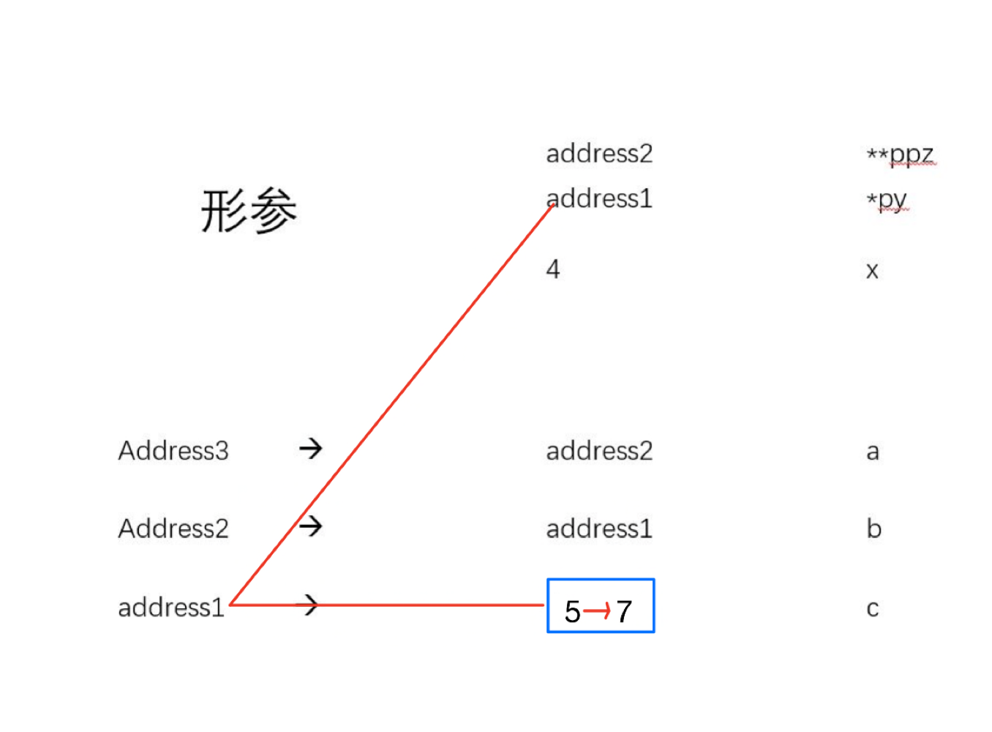
*py+=2;

Slide 7
x+=3;
 | address2 | **ppz
形参 | address1 | *py
 | 4 + 3 = 7 | x
Address3 → | address2 | a
Address2 → | address1 | b
address1 → | 7 | c

Slide 8
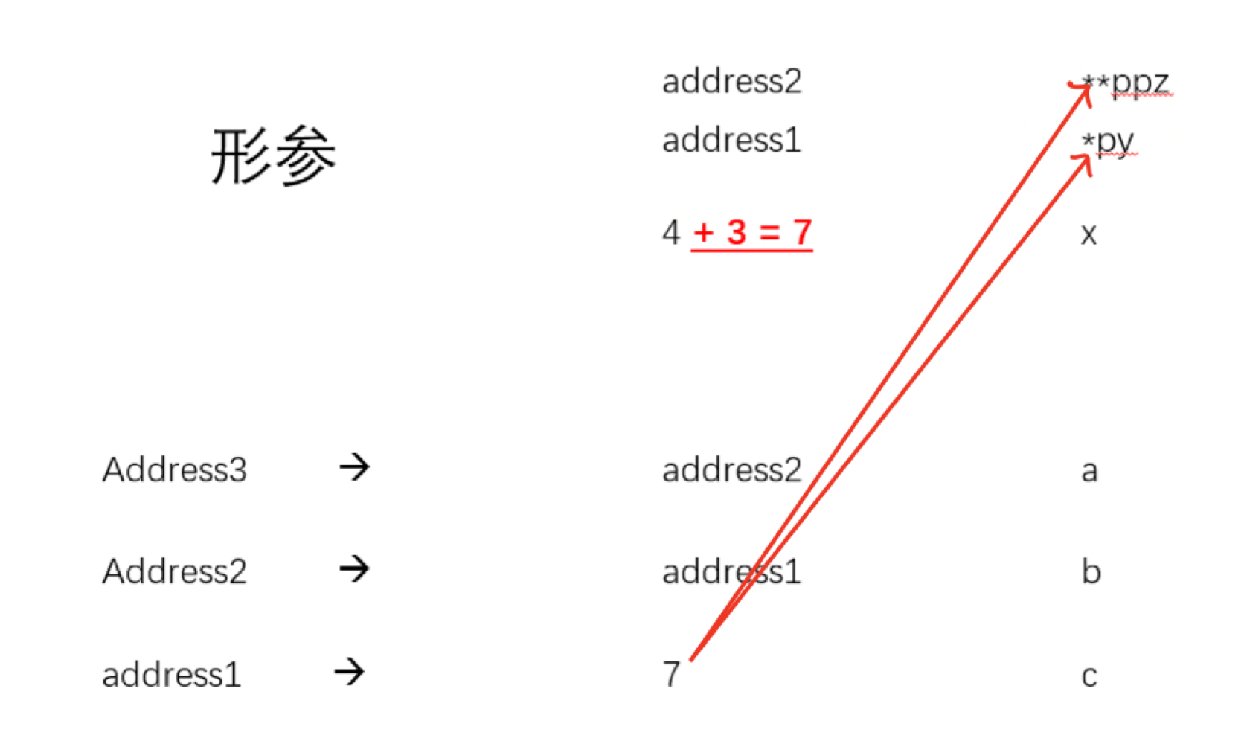
7
7
7
=21
return x + *py + **ppz;

